Slide 1
Machine Learning
Introduction to Machine Learning
By
Debasis Satapathy

Slide 2
Machine Learning
Part of a larger discipline called Data Science
Machine learning is a growing technology which enables computers to learn automatically from past data. Machine learning uses various algorithms for building mathematical models and making predictions using historical data or information.
Ex- Image recognition, speech recognition, email filtering, Facebook auto-tagging, recommender system, and many more
Data science is the process of applying science and domain expertise to data to extract useful information from data.
Application of all the statistical and mathematical tools and techniques to extract the useful information from data.
“[Machine Learning is the] field of study that gives computers the ability to learn without being explicitly programmed.” Arthur Samuel 1959:
To make decisions, based on data, with efficiency and scale

Slide 3
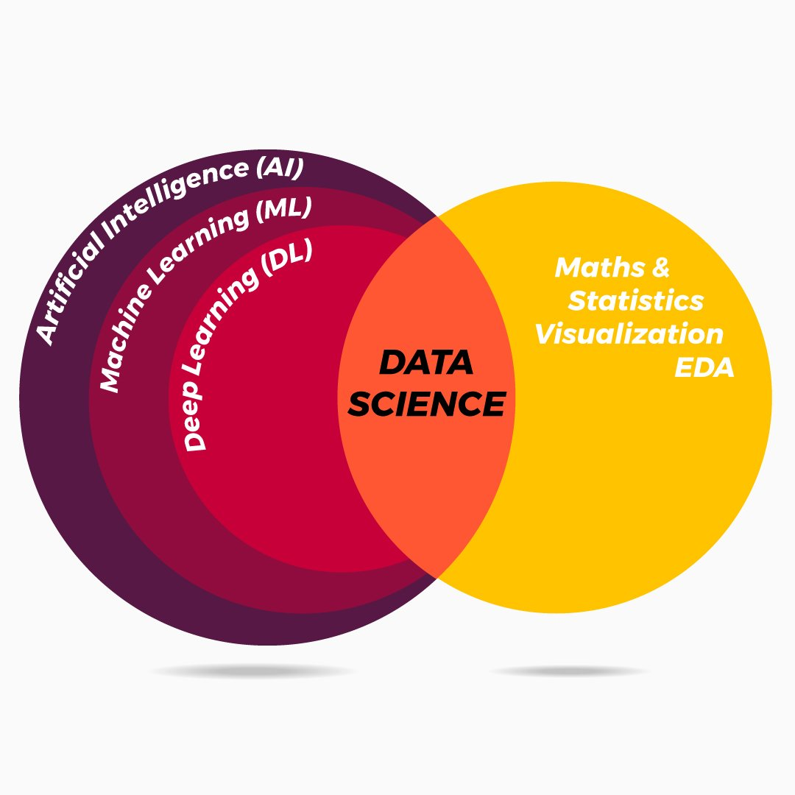

Slide 4
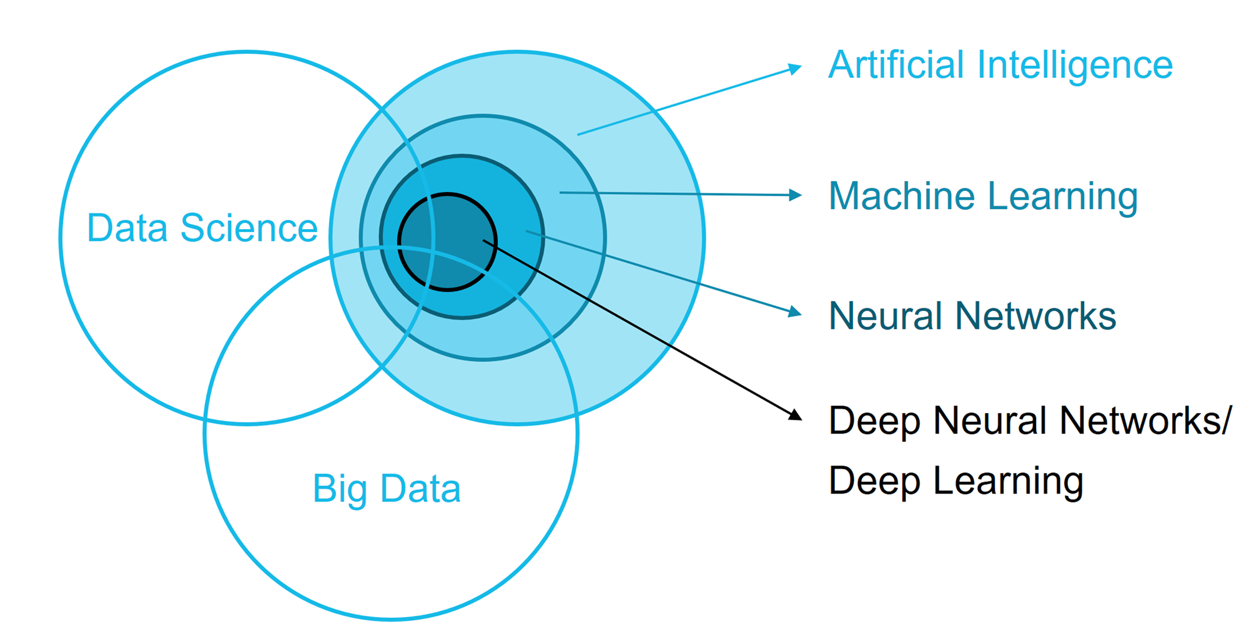

Slide 5
Prerequisites Skills
Fundamental knowledge of probability and linear algebra.
The ability to code in any computer language, especially in Python language.
Knowledge of Calculus, especially derivatives of single variable and multivariate functions.

Slide 6
Different Packages for Python for ML
Numpy, OpenCV, and Scikit are used when working with images
NLTK along with Numpy and Scikit again when working with text
Librosa for audio applications
Matplotlib, Seaborn, and Scikit for data representation
TensorFlow and Pytorch for Deep Learning applications
Scipy for Scientific Computing
Django for integrating web applications
Pandas for high-level data structures and analysis

Slide 7
Machine Learning
Why Machine Learning is popular only now
1.More Data
2.Computing Power
3.Ready Algorithms Implementations
a. Because of Better Software Development Approach
4.New Technologies
a.Cloud Computing
b.Big Data

Slide 8
Importance of Machine Learning
Rapid increment in the production of data
Solving complex problems, which are difficult for a human
Decision making in various sector including finance
Finding hidden patterns and extracting useful information from data.
Features of Machine Learning
Machine learning uses data to detect various patterns in a given dataset.
It can learn from past data and improve automatically.
It is a data-driven technology.
Machine learning is much similar to data mining as it also deals with the huge amount of the data

Slide 9
Machine Learning
What do machine learning algorithms do?
Search through data to look for patterns
Patterns in form of trends, cycles, associations, classes etc.
Express these patterns as mathematical structures such as mathematical equations.
These expressions is broadly called models

Slide 10
When is machine learning useful ?
Cannot express our knowledge about patterns as a program. For e.g. Character recognition or natural language processing
Do not have an algorithm to identify a pattern of interest. For e.g. In spam mail detection
Too complex and dynamic. For e.g. Weather forecasting
Too many permutations and combinations possible. For e.g. Genetic code mapping
No prior experience or knowledge. For e.g. Chandrayan 2
Patterns hidden in humongous data. For e.g. Recommendation system

Slide 11
Why & When to Make Machines Learn
Lack of human expertise- The very first scenario in which we want a machine to learn and take data-driven decisions, can be the domain where there is a lack of human expertise. The examples can be navigations in unknown territories or spatial planets.
Dynamic scenarios- There are some scenarios which are dynamic in nature i.e. they keep changing over time. In case of these scenarios and behaviors, we want a machine to learn and take data-driven decisions. Some of the examples can be network connectivity and availability of infrastructure in an organization.
Difficulty in translating expertise into computational tasks- There can be various domains in which humans have their expertise,; however, they are unable to translate this expertise into computational tasks. In such circumstances we want machine learning. The examples can be the domains of speech recognition, cognitive tasks etc.

Slide 12
Machine Learning
Machine learning is programming computers to optimize a performance criterion using example data or past experience.
There is no need to “learn” to calculate payroll
Learning is used when:
Human expertise does not exist (navigating on Mars),
Humans are unable to explain their expertise (speech recognition)
Solution changes in time (routing on a computer network)
Solution needs to be adapted to particular cases (user biometrics)

Slide 13
Data Mining
Retail: Market basket analysis, Customer relationship management (CRM)
Finance: Credit scoring, fraud detection
Manufacturing: Control, robotics, troubleshooting
Medicine: Medical diagnosis
Telecommunications: Spam filters, intrusion detection
Bioinformatics: Motifs, alignment
Web mining: Search engines

Slide 14
What is Machine Learning?
Optimize a performance criterion using example data or past experience.
Role of Statistics: Inference from a sample
Role of Computer science: Efficient algorithms to
Solve the optimization problem
Representing and evaluating the model for inference

Slide 15
Classification: Applications
Aka Pattern recognition
Face recognition: Pose, lighting, occlusion (glasses, beard), make-up, hair style
Character recognition: Different handwriting styles.
Speech recognition: Temporal dependency.
Medical diagnosis: From symptoms to illnesses
Biometrics: Recognition/authentication using physical and/or behavioral characteristics: Face, iris, signature, etc
Outlier/novelty detection:

Slide 16
Challenges in Machines Learning
Quality of data − Having good-quality data for ML algorithms is one of the biggest challenges. Use of low-quality data leads to the problems related to data preprocessing and feature extraction.
Time-Consuming task − Another challenge faced by ML models is the consumption of time especially for data acquisition, feature extraction and retrieval.
Lack of specialist persons − As ML technology is still in its infancy stage, availability of expert resources is a tough job.
No clear objective for formulating business problems − Having no clear objective and well-defined goal for business problems is another key challenge for ML because this technology is not that mature yet.
Issue of overfitting & underfitting − If the model is overfitting or underfitting, it cannot be represented well for the problem.
Curse of dimensionality − Another challenge ML model faces is too many features of data points. This can be a real hindrance.
Difficulty in deployment − Complexity of the ML model makes it quite difficult to be deployed in real life.

Slide 17
Applications of Machines Learning
Emotion analysis
Sentiment analysis
Error detection and prevention
Weather forecasting and prediction
Stock market analysis and forecasting
Speech synthesis
Speech recognition
Customer segmentation
Object recognition
Fraud detection
Fraud prevention
Recommendation of products to customer in online shopping.
Dynamic pricing models / strategies
Email spam filtering

Slide 18
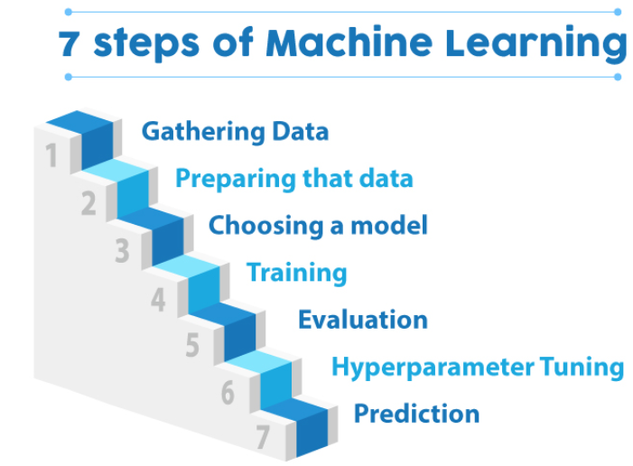

Slide 19
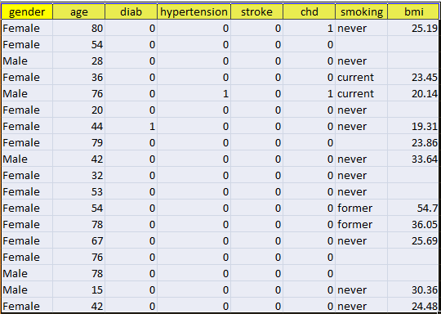
Machine Learning
Machine learning happens in mathematical space / feature space
A data set representing the real world, is a collection attributes that define an entity
Each entity is represented as one record / line in the data set

Slide 20
Machine Learning
Model: A model is a specific representation learned from data by applying some machine learning algorithm. A model is also called hypothesis.
Feature: A feature is an individual measurable property of our data. A set of numeric features can be conveniently described by a feature vector. Feature vectors are fed as input to the model. For example, in order to predict a fruit, there may be features like color, smell, taste, etc.
Target(Label): A target variable or label is the value to be predicted by our model. For the fruit example discussed in the features section, the label with each set of input would be the name of the fruit like apple, orange, banana, etc.
Training: The idea is to give a set of inputs(features) and it’s expected outputs(labels), so after training, we will have a model (hypothesis) that will then map new data to one of the categories trained on.
Prediction: Once our model is ready, it can be fed a set of inputs to which it will provide a predicted output(label).

Slide 21

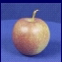
Steps
Training
Training Labels
Training Images
Image Features
Training
Learned model
Testing
Image Features
Learned model
Prediction
Test Image
Slide credit: D. Hoiem and L. Lazebnik

Slide 22
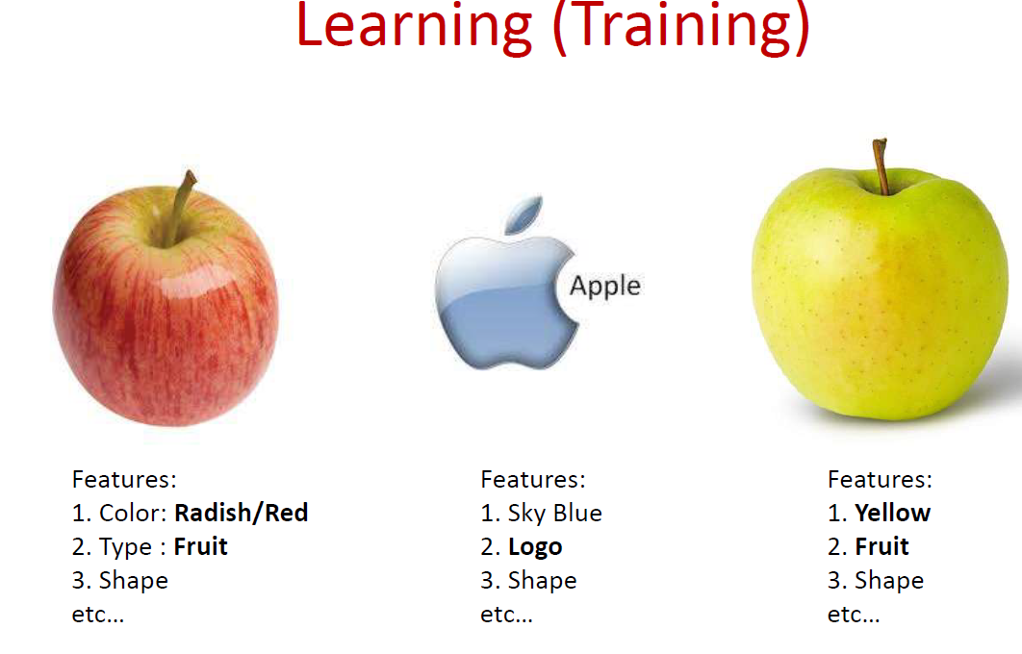

Slide 23
Types of Learning
Supervised (inductive) learning
Training data includes desired outputs
Unsupervised learning
Training data does not include desired outputs
Semi-supervised learning
Training data includes a few desired outputs
Reinforcement learning
Rewards from sequence of actions

Slide 24
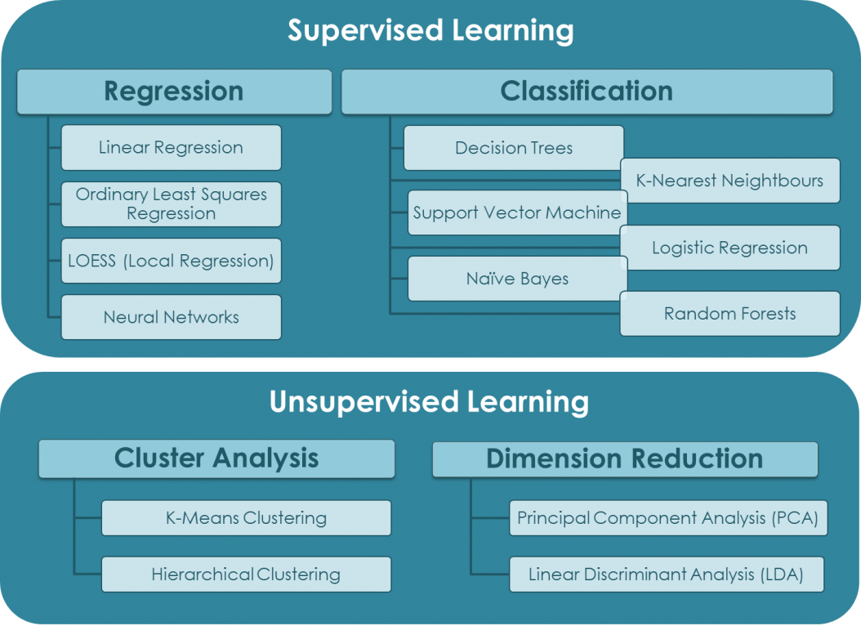
Machine Learning Categories
Source: https://quantdare.com/machine-learning-a-brief-breakdown/

Slide 25
What is classification?
A machine learning task that deals with identifying the class to which an instance belongs
A classifier performs classification
Training
phase
Testing
phase
Learning the classifier
from the available data
‘Training set’
(Labeled)
Testing how well the classifier
performs
‘Testing set’

Slide 26
Machine Learning
Evaluating classifiers
Outcome:
Accuracy
Confusion matrix
If cost-sensitive, the expected cost of classification ( attribute test cost + misclassification cost)
etc.

Slide 27

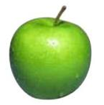


Supervised learning
examples
label
label₁
label₃
labeled examples
label₄
label₅
Supervised learning: given labeled examples

Slide 28
Supervised learning
label
label₁
model/
predictor
label₃
label₄
label₅
Supervised learning: given labeled examples

Slide 29
Supervised learning: classification
label
apple
Classification: a finite set of labels
apple
banana
banana
Supervised learning: given labeled examples

Slide 30
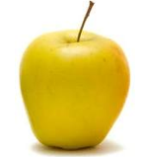
Supervised learning
model/
predictor
predicted label
Supervised learning: learn to predict new example

Slide 31
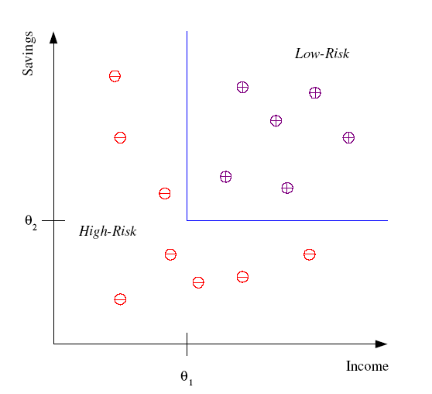
Classification Example
Differentiate between low-risk and high-risk customers from their income and savings

Slide 32
Classification Applications
Face recognition
Character recognition
Spam detection
Medical diagnosis: From symptoms to illnesses

Slide 33
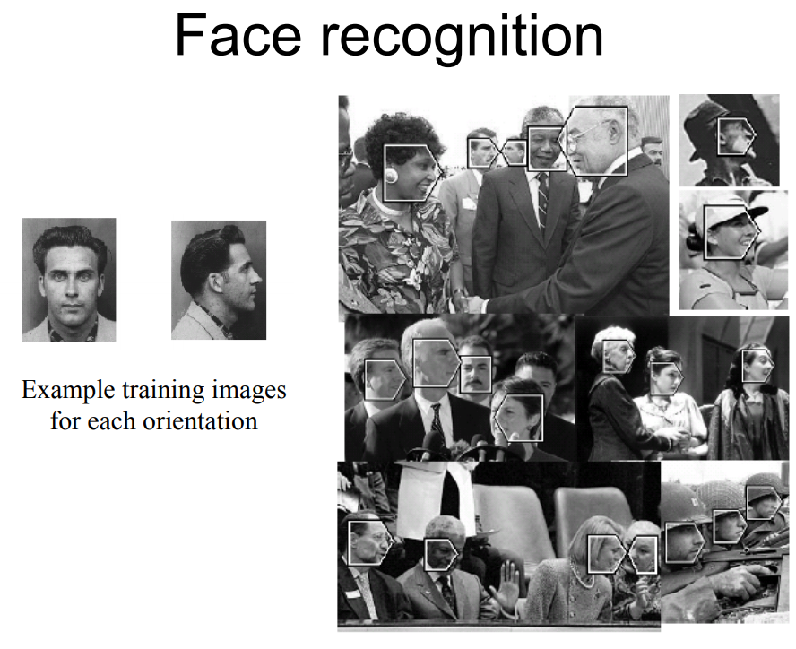

Slide 34
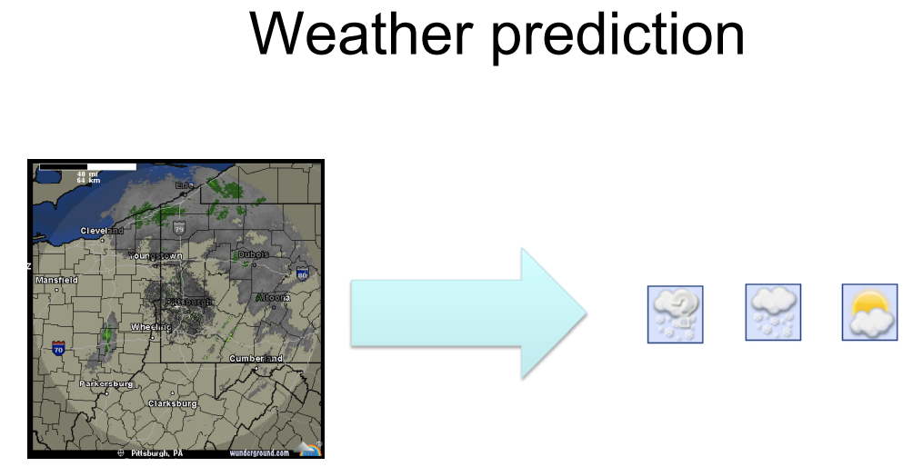

Slide 35
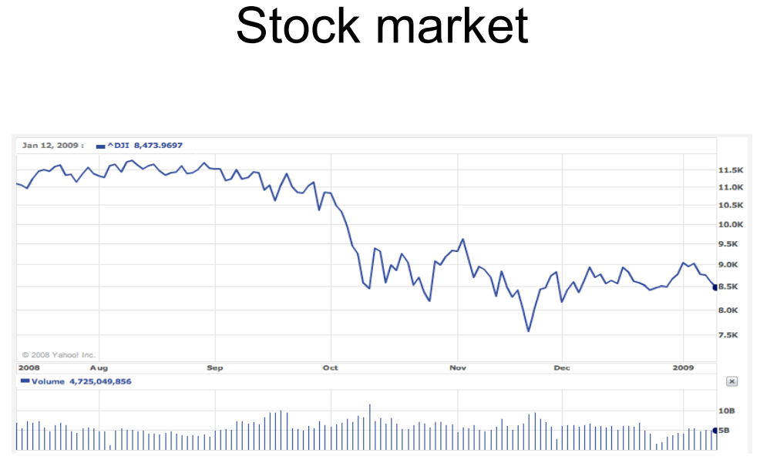

Slide 36


Slide 37
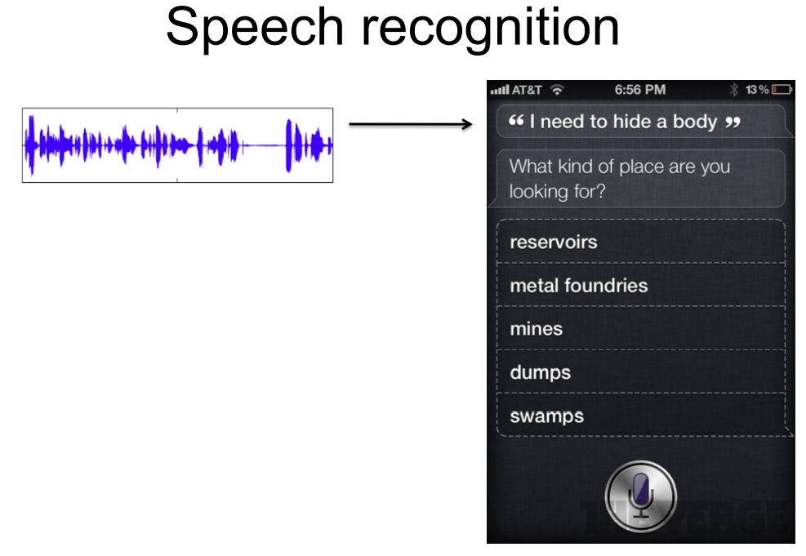

Slide 38
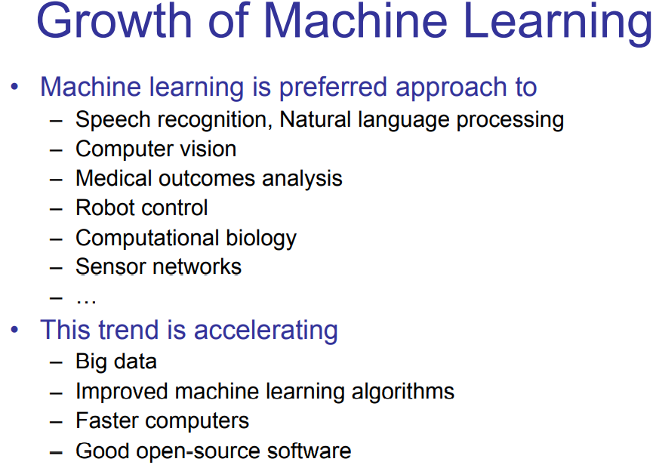

Slide 39
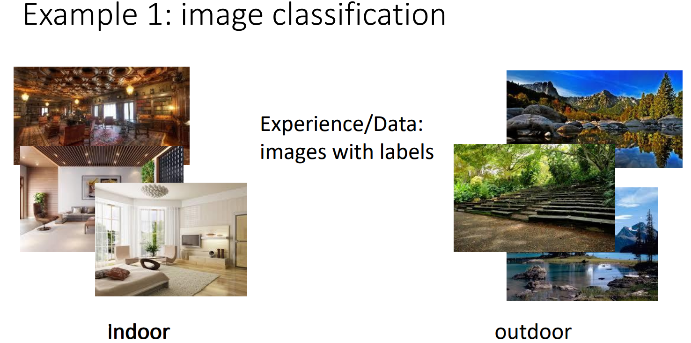

Slide 40
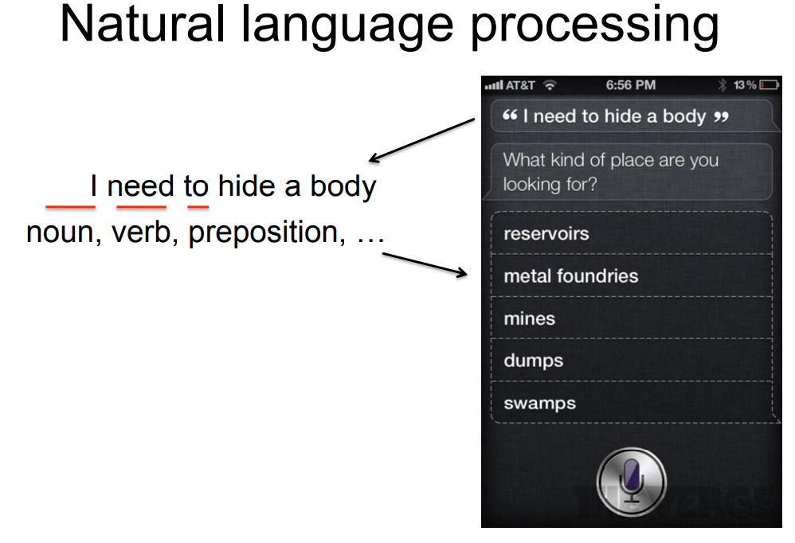

Slide 41
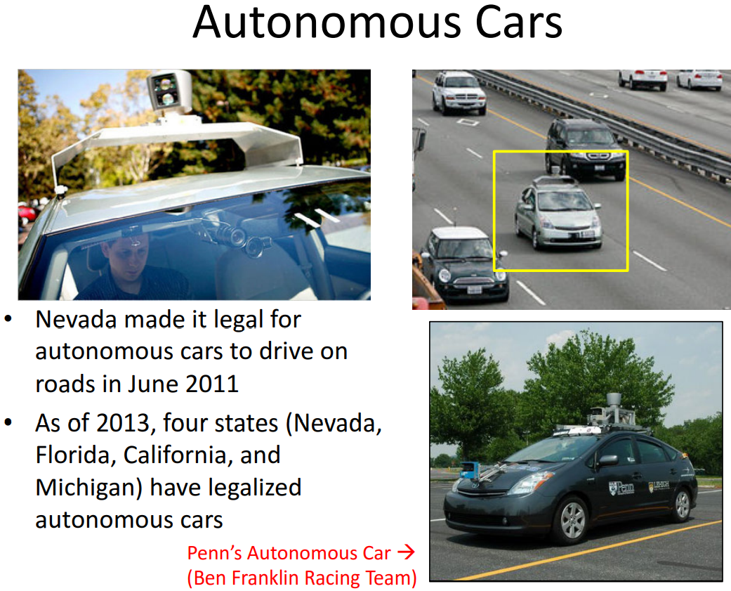

Slide 42
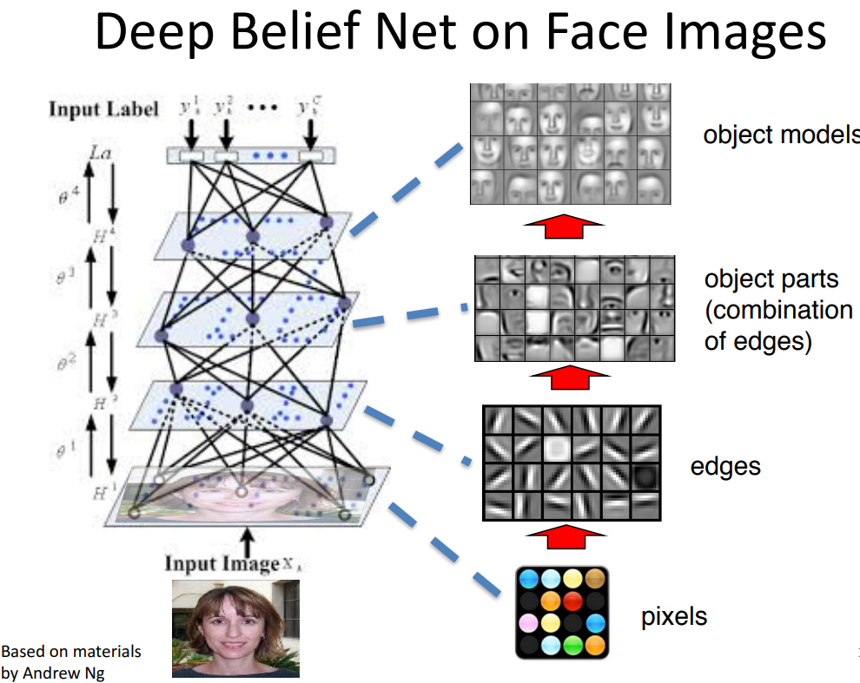

Slide 43
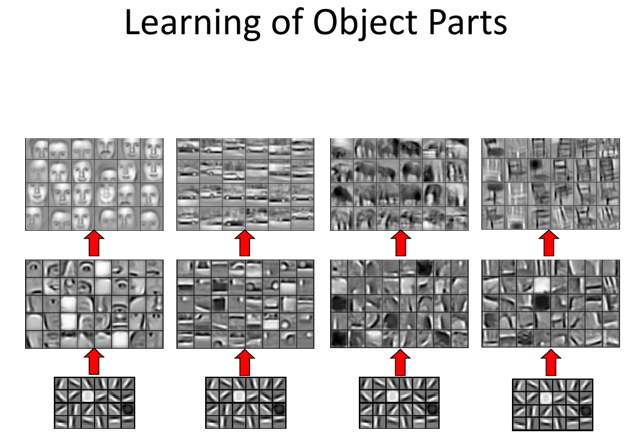

Slide 44
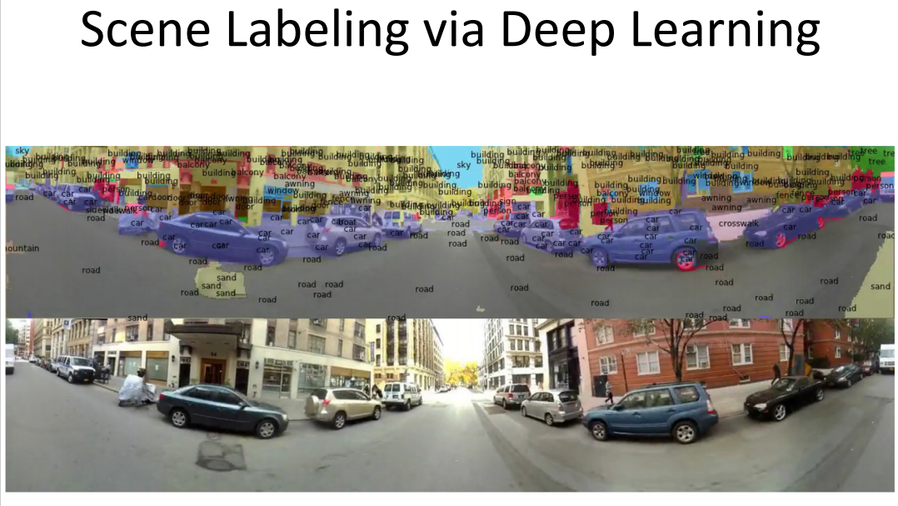

Slide 45
Supervised learning: regression
label
4.5
Regression: label is real-valued
10.1
3.2
4.3
Supervised learning: given labeled examples

Slide 46
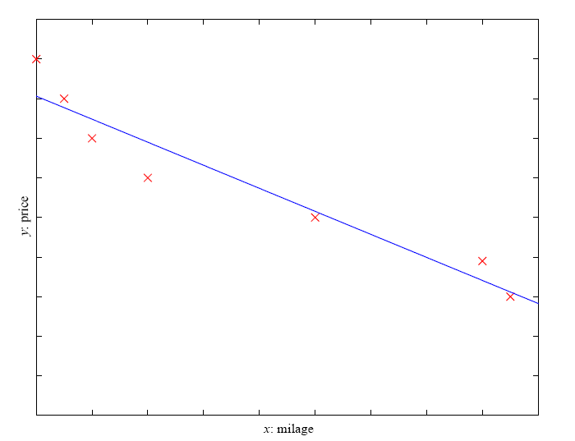
Regression Example
Price of a used car
x : car attributes (e.g. mileage)
y : price
y = wx+w₀

Slide 47
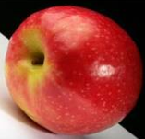
Unsupervised learning
Unupervised learning: given data, i.e. examples, but no labels

Slide 48
Reinforcement learning
left, right, straight, left, left, left, straight
GOOD
left, straight, straight, left, right, straight, straight
BAD
left, right, straight, left, left, left, straight
18.5
left, straight, straight, left, right, straight, straight
-3
Given a sequence of examples/states and a reward after completing that sequence, learn to predict the action to take in for an individual example/state

Slide 49
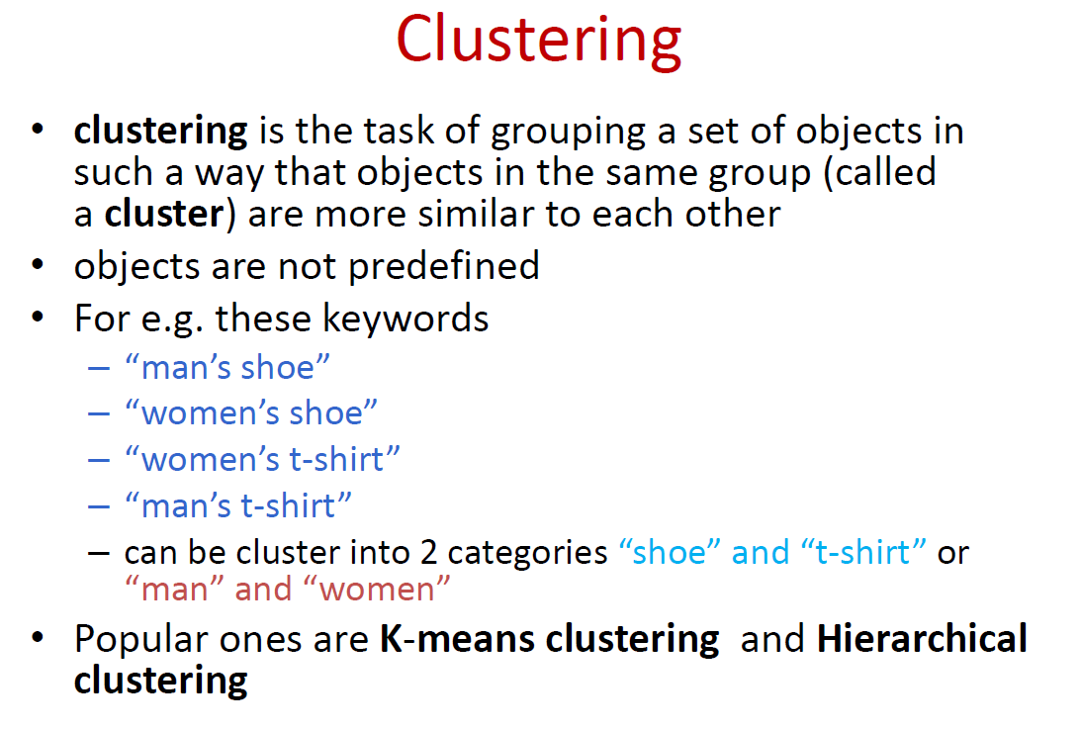

Slide 50
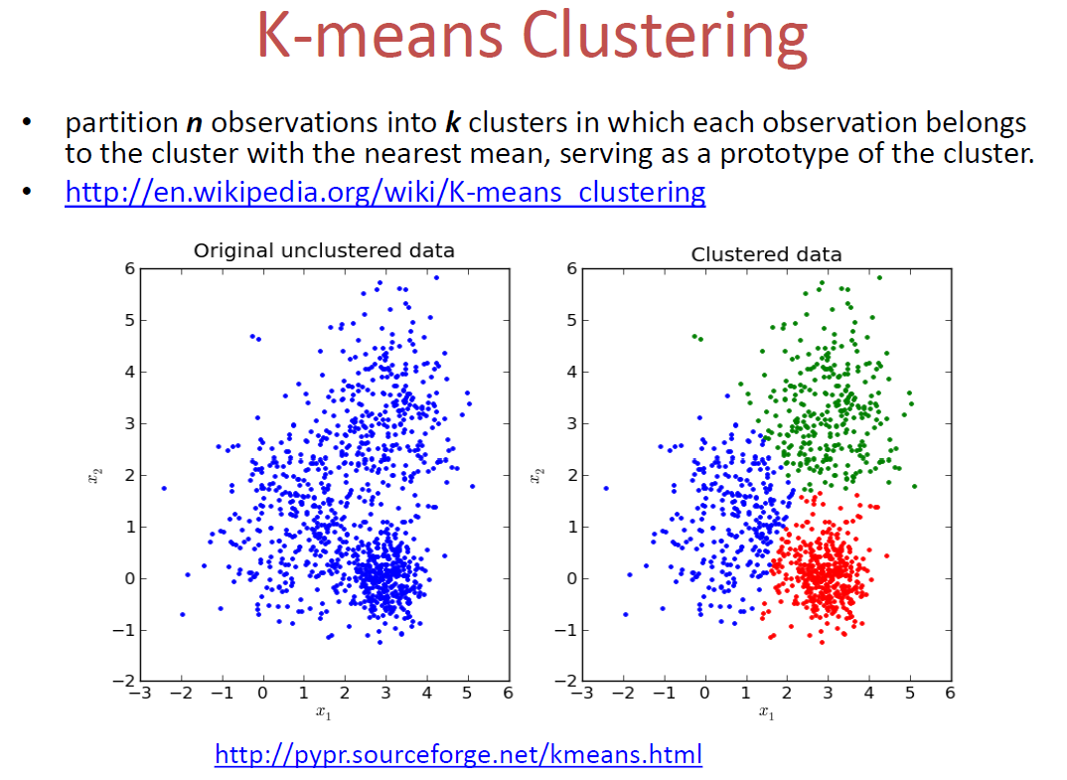

Slide 51
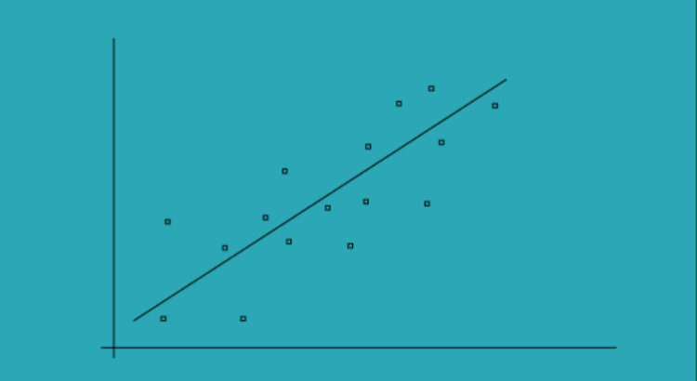
Linear regression
The simple linear regression models are used to show or predict the relationship between the two variables or factors
The factor that being predicted is called dependent variable and the factors that is are used to predict the dependent variable are called independent variables
Simple Linear regression

Slide 52
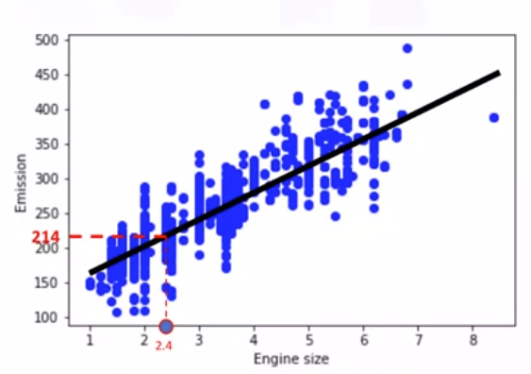
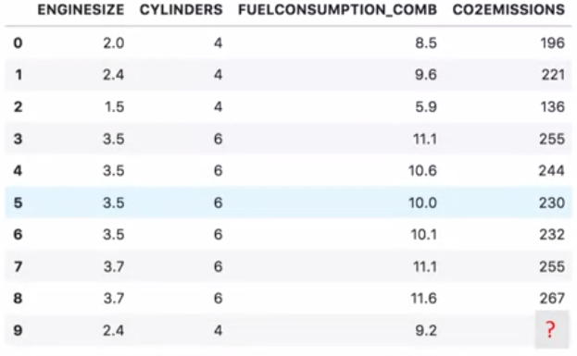
Linear regression
Predicting C02 emission with engine size feature using simple linear regression

Slide 53
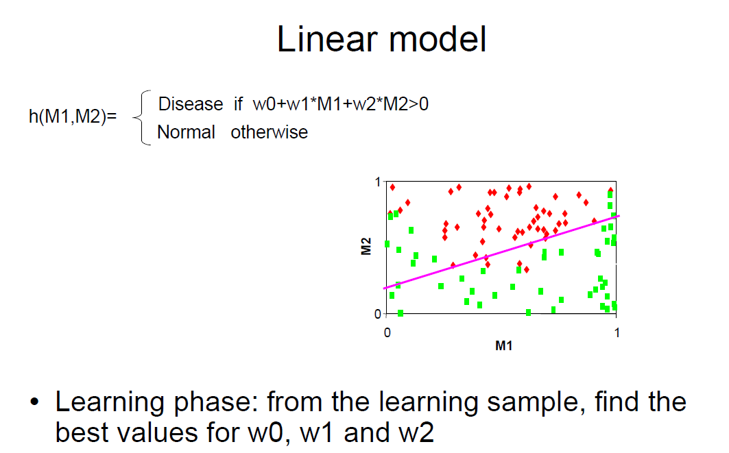
Machine Learning

Slide 54
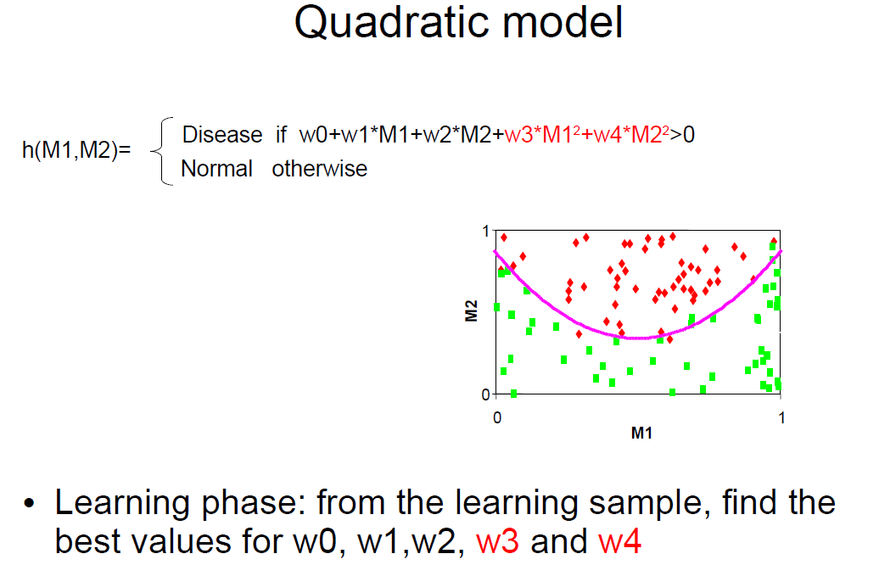
Machine Learning

Slide 55
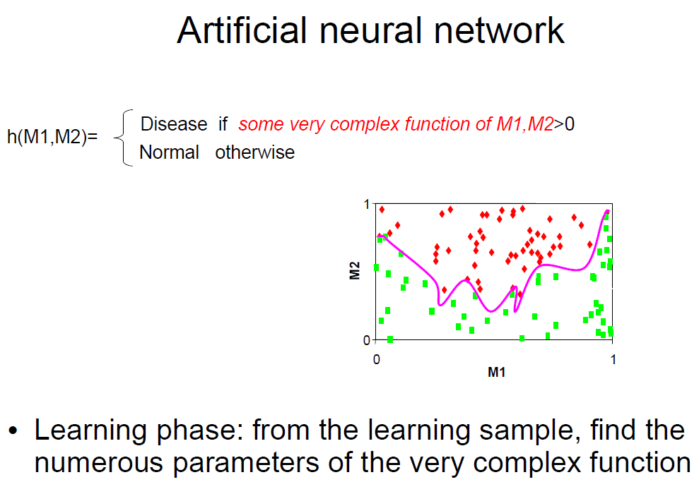
Machine Learning

Slide 56
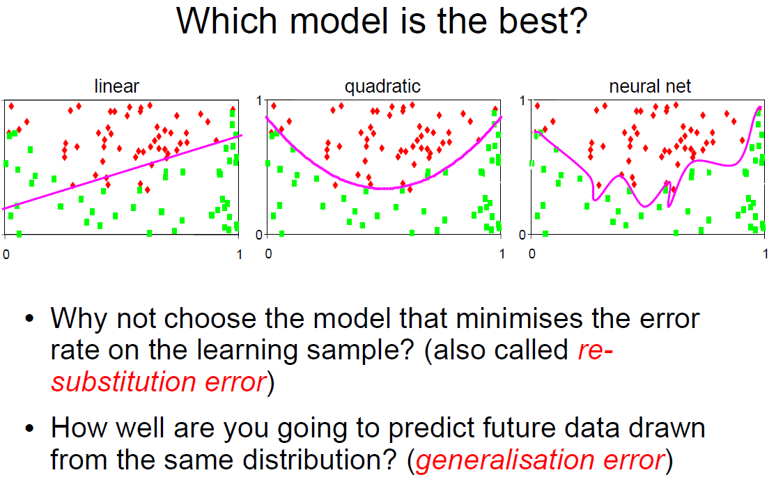
Machine Learning

Slide 57
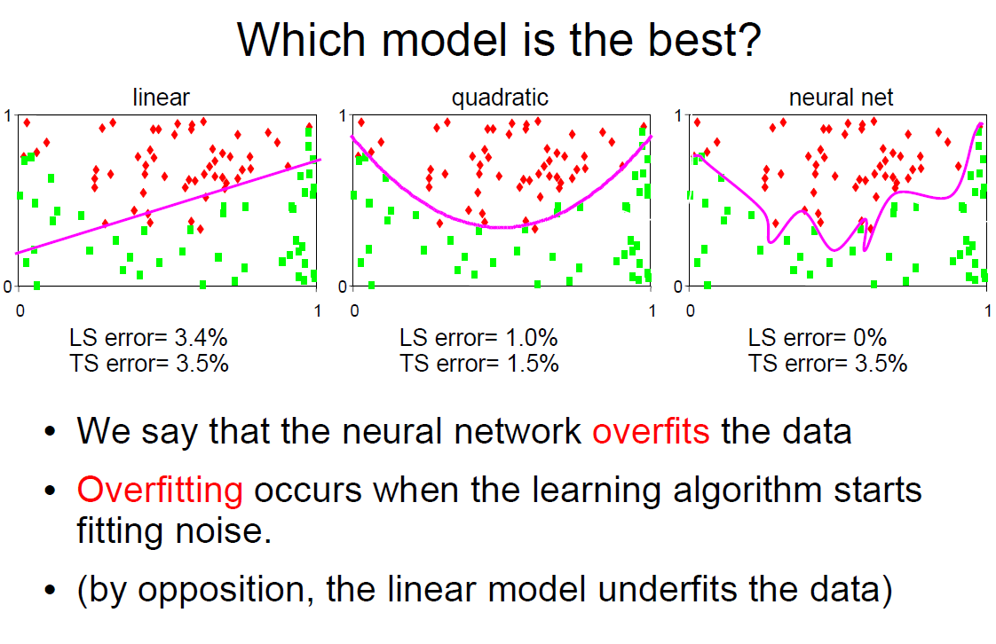

Slide 58
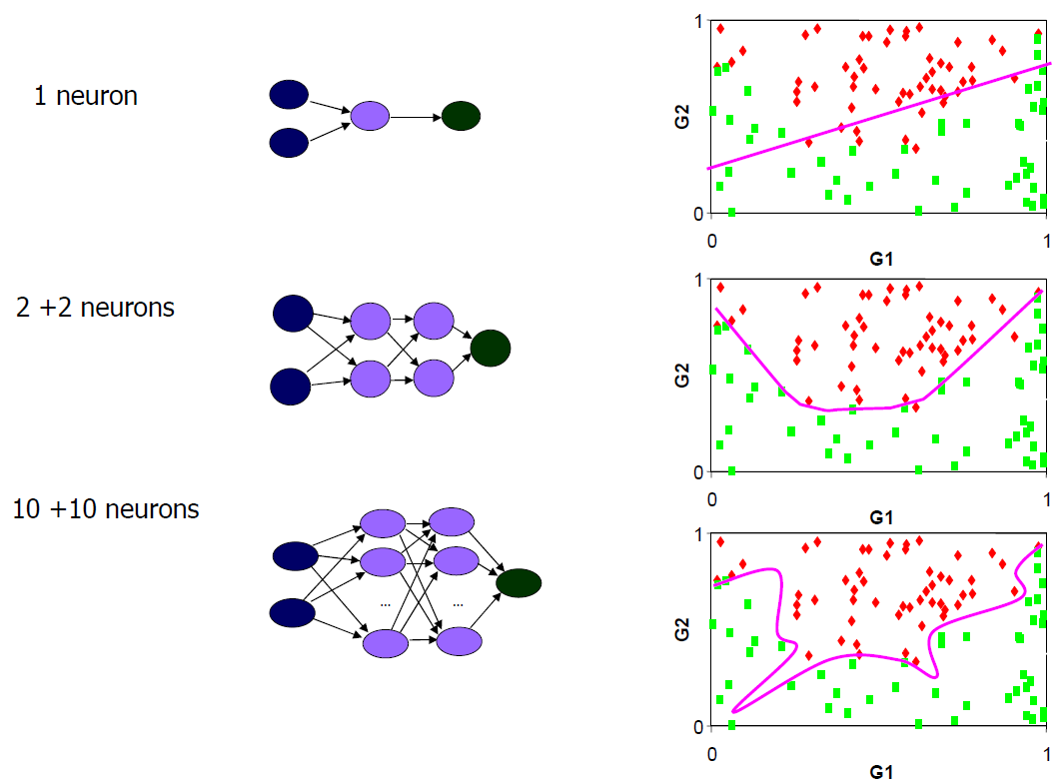

Slide 59
Many classifiers to choose from
Which is the best one?
SVM
Neural networks
Naïve Bayes
Logistic regression
RandomForest
Decision Trees
K-nearest neighbor
Slide credit: D. Hoiem

Slide 60
Machine Learning
CAT
DOG
CAR
Apple

Slide 61
Machine Learning
Prediction

Slide 62
Machine Learning
1.RAW Data Collection
a. BeautifulSoup library
b. Streaming source –Kafka, Flume
2.Data Presentation & Cleanup
a. Pandas library
3.Data Visualization
a. Matplotlib and Seaborn library
4. Data Pipeline & feature engineering
a. Create the right features from raw data for the ML Task.
5.ML Modeling
a. Tensorflow/ SkLearn library
6. Deployment & BI Reports

Slide 63
Machine Learning Use cases
Chatbots
Healthcare: Patient Disease Diagnosis
Automobile: Self Driving Car
Retail: Recommendation Engine
Job Hiring: Resume Shortlisting
Customer Service: Sentiment Analysis, text analytics
Finance: Fraud detection, Credit scoring
Web mining: Search engines

